Slide 1


GSA Hackathon
Data Center Mashup Tool
Presented by Octo Consulting Group
10/16/2015

Slide 2
The Team
Tarandeep Dhupar
Technical Lead/
Data Analyst
UI/Front End Development
Dave Reed
Scott Stanton
UX Design
Nitin Emmanuel
Raymond Lattanzio
Jagannath Chakravarty
Services Development
Sreedhar Bogarrapu
Mehul Soni

Slide 3
Problem Vision
FOR: GSA IT, GSA Management, Data Center Staff Offices and OMB
WHO: wants to maintain a data center inventory, analyze it and generate reports
THE: Data Center Dashboard
IS A: Data Center Inventory Portal
THAT: Consolidates the ability to maintain, analyze and reports data center inventory
UNLIKE: the current disparate inventory data collection process
OUR SOLUTION: is the next generation method to collect and report on data center inventory data
SUCCESS CRITERIA:
Create a centralized inventory and portal where all staff offices can input their data and updates inventory in real time
Creating relational tables where data can be queries, re-arranged and viewed for analysis
Put controls in place that ensures data accuracy and integrity
Ability to compute quarterly data center costs by comparing inventories to the last quarter and applying cost savings and avoidance metrics
Maintain an audit trail for each quarter
Ability to be tailored to reflect government agency realities and changing OMB guidance.

Slide 4
How did we do it?
Kanban style Just In Time Development (Not Started, In Progress, Completed)
Responsive Design/Mobile First
Micro-Services based Architecture
Persona, Scenario and Flow Development

Slide 5
What did we use?
UI: AngularJS, Bootstrap
Services: Loop Back, NodeJS
Database: MySQL
Reporting: BIRT
UX: BootStrap (Wireframes), Sublime Text, “Paper” Prototyping

Slide 6
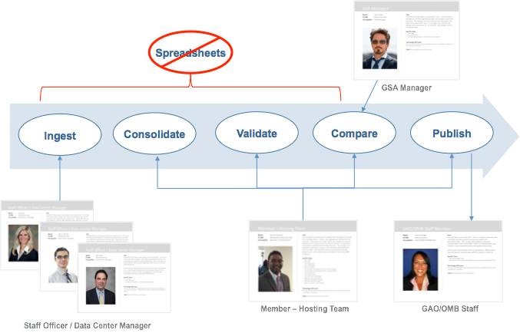
Why did we do it?

Slide 7
SHOW TIME!

